Slide 1


CPSC 221: Algorithms and Data Structures Lecture #7 Sweet, Sweet Tree Hives
(B+-Trees, that is)
Steve Wolfman
2014W1
Notes:
TODO (future terms): update term

Slide 2
Today’s Outline
Addressing our other problem
B+-tree properties
Implementing B+-tree insertion and deletion
Some final thoughts on B+-trees

Slide 3

M-ary Search Tree
Maximum branching factor of M
Complete tree has height h ≅ log_{M}N
Each internal node in a complete tree has
M - 1 keys
runtime:
Notes:
So, we’ll try to solve this problem as we did with heaps.
Here’s the general idea. We create a search tree with a branching factor of M.
Each node has M-1 keys and we search between them.
What’s the runtime?
O(log_{M}n)?
That’s a nice thought, and it’s the best case. What about the worst case?
Is the tree guaranteed to be balanced?
Is it guaranteed to be complete?
Might it just end up being a binary tree?

Slide 4
Incomplete M-ary Search Tree ☹
Just like a binary tree, though, complete m-ary trees can store m⁰ keys, m⁰ + m¹ keys, m⁰ + m¹ + m² keys, …
What about numbers in between??
Notes:
So, we’ll try to solve this problem as we did with heaps.
Here’s the general idea. We create a search tree with a branching factor of M.
Each node has M-1 keys and we search between them.
What’s the runtime?
O(log_{M}n)?
That’s a nice thought, and it’s the best case. What about the worst case?
Is the tree guaranteed to be balanced?
Is it guaranteed to be complete?
Might it just end up being a binary tree?

Slide 5
B+-Trees
B+-Trees are specialized M-ary search trees
Each node has many keys
at least some minimum # of keys
subtree between two keys x and y contains values v such that x ≤ v < y
binary search within a node
to find correct subtree
Each node takes one full {page, block, line} of memory
ALL the leaves are at the same depth!
3
7
12
21
x<3
3≤x<7
7≤x<12
12≤x<21
21≤x
Notes:
To address these problems, we’ll use a slightly more structured M-ary tree: B-Trees.
As before, each internal node has M-1 kes.
To manage memory problems, we’ll tune the size of a node (or leaf) to the size of a memory unit. Usually, a page or disk block.

Slide 6
Today’s Outline
Addressing our other problem
B+-tree properties
Implementing B+-tree insertion and deletion
Some final thoughts on B+-trees

Slide 7
B+-Tree Properties
Properties
maximum branching factor of M
the root has between 2 and M children or at most L keys/values
other internal nodes have between ⎡M/2⎤ and M children
internal nodes contain only search keys (no data)
smallest datum between search keys x and y equals x
each (non-root) leaf contains between ⎡L/2⎤ and L keys/values
all leaves are at the same depth
Result
tree is Θ(log_{M} n) deep (between log_{M/2} n and log_{M} n)
all operations run in Θ(log_{M} n) time
operations get about M/2 to M or L/2 to L items at a time
Notes:
The properties of B-Trees (and the trees themselves) are a bit more complex than previous structures we’ve looked at.
Here’s a big, gnarly list; we’ll go one step at a time.
The maximum branching factor, as we said, is M (tunable for a given tree).
The root has between 2 and M children or at most L keys.
(L is another parameter)
These restrictions will be different for the root than for other nodes.

Slide 8
B+-Tree Properties‡
Properties
maximum branching factor of M
the root has between 2 and M children or at most L keys/values
other internal nodes have between ⎡M/2⎤ and M children
internal nodes contain only search keys (no data)
smallest datum between search keys x and y equals x
each (non-root) leaf contains between ⎡L/2⎤ and L keys/values
all leaves are at the same depth
Result
tree is Θ(log_{M} n) deep (between log_{M/2} n and log_{M} n)
all operations run in Θ(log_{M} n) time
operations get about M/2 to M or L/2 to L items at a time
‡These are B⁺-Trees. B-Trees store data at internal nodes.
Notes:
All the other internal nodes (non-leaves) will have between M/2 and M children.
The funky symbol is ceiling, the next higher integer above the value.
The result of this is that the tree is “pretty” full. Not every node has M children but they’ve all at least got M/2 (a good number).
Internal nodes contain only search keys.
A search key is a value which is solely for comparison; there’s no data attached to it.
The node will have one fewer search key than it has children (subtrees) so that we can search down to each child.
The smallest datum between two search keys is equal to the lesser search key.
This is how we find the search keys to use.

Slide 9
B+-Tree Properties
Properties
maximum branching factor of M
the root has between 2 and M children or at most L keys/values
other internal nodes have between ⎡M/2⎤ and M children
internal nodes contain only search keys (no data)
smallest datum between search keys x and y equals x
each (non-root) leaf contains between ⎡L/2⎤ and L keys/values
all leaves are at the same depth
Result
tree is Θ(log_{M} n) deep (between log_{M/2} n and log_{M} n)
all operations run in Θ(log_{M} n) time
operations get about M/2 to M or L/2 to L items at a time
Notes:
All the leaves (again, except the root) have a similar restriction.
They contain between L/2 and L keys.
Notice that means you have to do a search when you get to a leaf to find the item you’re looking for.
All the leaves are also at the same depth. So, the tree looks kind of complete.
It has the triangle shape, and the nodes branch at least as much as M/2.

Slide 10
B+-Tree Properties
Properties
maximum branching factor of M
the root has between 2 and M children or at most L keys/values
other internal nodes have between ⎡M/2⎤ and M children
internal nodes contain only search keys (no data)
smallest datum between search keys x and y equals x
each (non-root) leaf contains between ⎡L/2⎤ and L keys/values
all leaves are at the same depth
Result
height is Θ(log_{M} n) between log_{M/2} (2n/L) and log_{M} (n/L)
all operations run in Θ(log_{M} n) time
operations get about M/2 to M or L/2 to L items at a time
Notes:
The result of all this is that the tree in the worst case is log n deep.
In particular, it’s about log_{M/2}n deep.
Does this matter asymptotically?
No.
What about practically?
YES!
Since M and L are considered constants, all operations run in log n time.
Each operation pulls in at most M search keys or L items at a time.
So, we can tune L and M to the size of a disk block!

Slide 11
Today’s Outline
Addressing our other problem
B+-tree properties
Implementing B+-tree insertion and deletion
Some final thoughts on B+-trees

Slide 12
B+-Tree Nodes
Internal node
i search keys; i+1 subtrees; M - i - 1 inactive entries
k₁
k₂
…
k_{i}
__
…
__
1
2
i
M - 1
Leaf
j data keys; L - j inactive entries
k₁
k₂
…
k_{j}
__
…
__
1
2
j
L
Notes:
FIX M-I to M-I-1!!
Alright, before we look at any examples, let’s look at what the node structure looks like.
Internal nodes are arrays of pointers to children interspersed with search keys.
Why must they be arrays rather than linked lists?
Because we want contiguous memory!
If the node has just I+1 children, it has I search keys, and M-I empty entries.
A leaf looks similar (I’ll use green for leaves), and has similar properties.
Why are these different?
Because internal nodes need subtrees-1 keys.

Slide 13
Example
B+-Tree with M = 4
and L = 4
10
40
3
15
20
30
50
1
2
10
11
12
20
25
26
40
42
3
5
6
9
15
17
30
32
33
36
50
60
70
As with other dictionary data structures, we show a version with no data, only keys, but only for simplicity!
Notes:
This is just an example B-tree. Notice that it has 24 entries with a depth of only 2.
A BST would be 4 deep.
Notice also that the leaves are at the same level in the tree. I’ll use integers as both key and data, but we all know that that could as well be different data at the bottom, right?

Slide 14
Making a B+-Tree
3
3
14
Insert(3)
Insert(14)
The empty B+-Tree
M = 3 L = 2
B-Tree with M = 3
and L = 2
Now, Insert(1)?
Notes:
Alright, how do we insert and delete?
Let’s start with the empty B-Tree. That’s one leaf as the root.
Now, we’ll insert 3 and 14. Fine…
What about inserting 1. Is there a problem?

Slide 15
Splitting the Root
Too many
keys in a leaf!
1
3
14
14
Insert(1)
And create
a new root
3
14
1
3
14
1
3
14
So, split the leaf.
Notes:
Too many keys in a leaf!
Run away!
How do we solve this?
Well, we definitely need to split this leaf in two.
But, now we don’t have a tree anymore.
So, let’s make a new root and give it as children the two leaves.
This is how B-Trees grow deeper.

Slide 16
Insertions and Split Ends
Too many
keys in a leaf!
14
14
14
Insert(59)
Insert(26)
1
3
14
26
59
1
3
14
1
3
14
59
14
26
59
So, split the leaf.
14
59
And add
a new child
1
3
14
26
59
Notes:
Now, let’s do some more inserts.
59 is no problem.
What about 26?
Same problem as before.
But, this time the split leaf just goes under the existing node because there’s still room.
What if there weren’t room?

Slide 17
Propagating Splits
14
59
14
59
Insert(5)
Add new
child
1
3
5
14
26
59
1
3
14
26
59
1
3
5
Too many keys in an internal node!
14
5
14
59
Create a
new root
5
59
5
59
1
3
5
14
26
59
1
3
5
14
26
59
So, split the node.
Notes:
When we insert 5, the leaf overflows, but its parent already has too many subtrees!
What do we do?
The same thing as before but this time with an internal node.
We split the node.
Normally, we’d hang the new subtrees under their parent, but in this case they don’t have one.
Now we have two trees!
Soltuion: same as before, make a new root and hang these under it.

Slide 18
Insertion in Boring Text
Insert the key in its leaf
If the leaf ends up with L+1 items, overflow!
Split the leaf into two nodes:
original with ⎡(L+1)/2⎤ items
new one with ⎣(L+1)/2⎦ items
Add the new child to the parent
If the parent ends up with M+1 items, overflow!
If an internal node ends up with M+1 items, overflow!
Split the node into two nodes:
original with ⎡(M+1)/2⎤ items
new one with ⎣(M+1)/2⎦ items
Add the new child to the parent
If the parent ends up with M+1 items, overflow!
Split an overflowed root in two and hang the new nodes under a new root
This makes the tree deeper!
Notes:
OK, here’s that process as an algorithm.
The new funky symbol is floor; that’s just like regular C++ integer division.
Notice that this can propagate all the way up the tree. How often will it do that?
Notice that the two new leaves or internal nodes are guaranteed to have enough items (or subtrees).
Because even the floor of (L+1)/2 is as big as the ceiling of L/2.

Slide 19
After More Routine Inserts
14
Insert(89)
Insert(79)
5
59
1
3
5
14
26
59
14
5
59
89
1
3
5
14
26
59
79
89
Notes:
OK, we’ve done insertion.
What about deletion?
For didactic purposes, I will now do two more regular old insertions (notice these cause a split).

Slide 20
Deletion
14
14
Delete(59)
5
59
89
5
79
89
1
3
5
14
26
59
79
89
1
3
5
14
26
79
89
Notes:
Now, let’s delete!
Just find the key to delete and snip it out!
Easy!
Done, right?

Slide 21
Deletion and Adoption
A leaf has too few keys!
14
14
Delete(5)
5
79
89
?
79
89
1
3
5
14
26
79
89
1
3
14
26
79
89
P.S. Parent + neighbour pointers. Expensive?
Definitely yes
Maybe yes
Not sure
Maybe no
Definitely no
So, borrow from a neighbor
14
3
79
89
1
3
3
14
26
79
89
Notes:
Of course not!
What if we delete an item in a leaf and drive it below L/2 items (in this case to zero)?
In that case, we have two options. The easy option is to borrow a neighbor’s item.
We just move it over from the neighbor and fix the parent’s key.
DIGRESSION: would it be expensive to maintain neighbor pointers in B-Trees?
No. Because those leaves are normally going to be huge, and two pointers per leaf is no big deal (might cut down L by 1).
How about parent pointers?
No problem. In fact, I’ve been assuming we have them!

Slide 22
Deletion with Propagation
A leaf has too few keys!
14
14
Delete(3)
3
79
89
?
79
89
1
3
14
26
79
89
1
14
26
79
89
And no neighbor with surplus!
But now a node
has too few subtrees!
WARNING: with larger L, can drop below L/2 without being empty! (Ditto for M.)
14
So, delete
the leaf
79
89
1
14
26
79
89
Notes:
But, what about if the neighbors are too low on items as well?
Then, we need to propagate the delete… like an _unsplit_.
We delete the node and fix up the parent.
Note that if I had a larger M/L, we might have keys left in the deleted node.
Why?
Because the leaf just needs to drop below ceil(L/2) to be deleted.
If L=100, L/2 = 50 and there are 49 keys to distribute!
Solution: Give them to the neighbors.
Now, what happens to the parent here?
It’s down to one subtree!
STRESS AGAIN THAT LARGER M and L WOULD MEAN NO NEED TO “RUN OUT”.

Slide 23
Finishing the Propagation (More Adoption)
14
79
Adopt a
neighbor
79
89
14
89
1
14
26
79
89
1
14
26
79
89
Notes:
We just do the same thing here that we did earlier:
Borrow from a rich neighbor!

Slide 24
A Bit More Adoption
79
79
Delete(1)
(adopt a
neighbor)
14
89
26
89
1
14
26
79
89
14
26
79
89
Notes:
OK, let’s do a bit of setup.
This is easy, right?

Slide 25
Pulling out the Root
A leaf has too few keys!
And no neighbor with surplus!
79
79
Delete(26)
So, delete
the leaf
26
89
89
14
26
79
89
14
79
89
But now the root
has just one subtree!
A node has too few subtrees
and no neighbor with surplus!
79
Delete
the leaf
79
89
89
14
79
89
14
79
89
Notes:
Now, let’s delete 26.
It can’t borrow from its neighbor, so we delete it.
Its parent is too low on children now and it can’t borrow either: Delete it.
Here, we give its leftovers to its neighbors as I mentioned earlier.
But now the root has just one subtree!!

Slide 26
Pulling out the Root (continued)
The root
has just one subtree!
Just make
the one child
the new root!
79
89
14
79
89
But that’s silly!
79
89
Note: The root really does only get deleted when it has just one subtree (no matter what M is).
14
79
89
Notes:
The root having just one subtree is both illegal and silly.
Why have the root if it just branches straight down?
So, we’ll just delete the root and replace it with its child!

Slide 27
Deletion in Two Boring Slides of Text
Remove the key from its leaf
If the leaf ends up with fewer than ⎡L/2⎤ items, underflow!
Adopt data from a neighbor; update the parent
If borrowing won’t work, delete node and divide keys between neighbors
If the parent ends up with fewer than ⎡M/2⎤ items, underflow!
Will dumping keys always work if adoption does not?
Yes
It depends
No
Notes:
Alright, that’s deletion.
Let’s talk about a few of the details.
Why will dumping keys always work?
If the neighbors were too low on keys to loan any, they must have L/2 keys, but we have one fewer. Therefore, putting them together, we get at most L, and that’s legal.

Slide 28
Deletion Slide Two
If a node ends up with fewer than ⎡M/2⎤ items, underflow!
Adopt subtrees from a neighbor; update the parent
If borrowing won’t work, delete node and divide subtrees between neighbors
If the parent ends up with fewer than ⎡M/2⎤ items, underflow!
If the root ends up with only one child, make the child the new root of the tree
This reduces the height of the tree!
Notes:
The same applies here for dumping subtrees as on the previous slide for dumping keys.

Slide 29
Today’s Outline
Addressing our other problem
B+-tree properties
Implementing B+-tree insertion and deletion
Some final thoughts on B+-trees

Slide 30
Thinking about B-Trees
B+-Tree insertion can cause (expensive) splitting and propagation (could we do something like borrowing?)
B+-Tree deletion can cause (cheap) borrowing or (expensive) deletion and propagation
Propagation is rare if M and L are large (Why?)
Repeated insertions and deletion can cause thrashing
If M = L = 128, then a B-Tree of height 4 will store at least 30,000,000 items
Notes:
B*-Trees fix thrashing.
Propagation is rare because (in a good case) only about 1/L inserts cause a split and only about 1/M of those go up even one level!
30 million’s not so big, right?
How about height 5?
2 billion

Slide 31
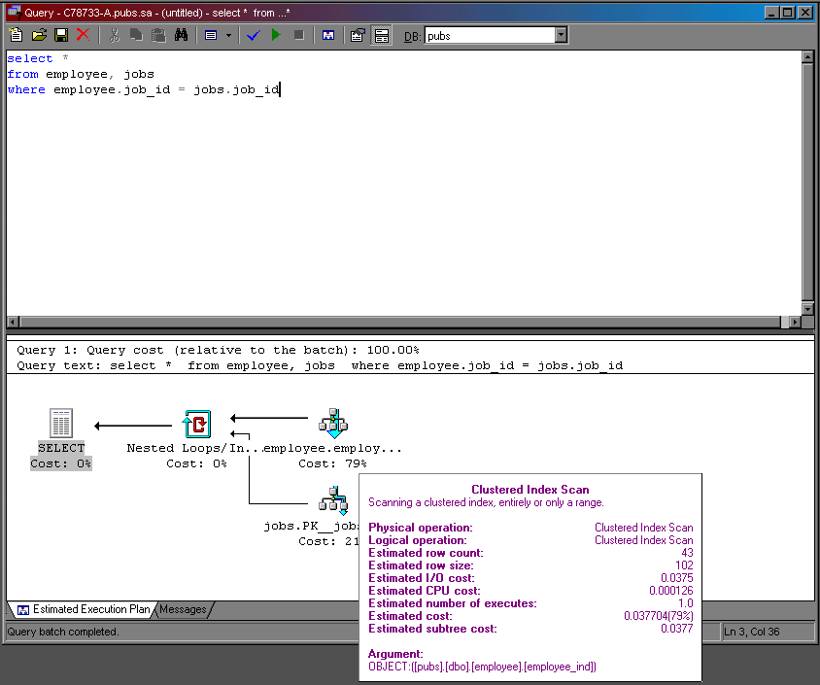
Cost of a Database Query (14 years ago… more skewed now!)
I/O to CPU ratio is 300!
Notes:
TODO (future terms): get a newer slide; that’s from 2000! It was a present from Rachel Pottinger (Steve’s wife)
Here’s the other present.
This is a trace of how much time a simple database operation takes: this one lists all employees along with their job information, getting the employee and job information from separate databases.
The thing to notice is that disk access takes something like 100 times as much time as processing. I told you disk access was expensive!
BTW: the “index” in the picture is a B-Tree.

Slide 32
A Tree with Any Other Name
FYI:
B+-Trees with M = 3, L = x are called 2-3 trees
B+-Trees with M = 4, L = x are called 2-3-4 trees
Other balanced trees include Red-Black trees (rotation-based), Splay Trees (rotation-based and amortized O(lg n) bounds), B-trees, B*-trees, …
Notes:
Why would we use these?
Not to fit disk blocks, most likely.
We might use them just to get the log n bound, however.

Slide 33
To Do
Hashing readings

Slide 34
Coming Up
In some order:
Everyone Gets a Crack at Parallelism
Hash Tables

